Slide 1
Deep Learning for Large-Scale Traffic-Sign Detection and Recognition Domen Tabernik and Danijel Skocaj
Course: 65017-סמינר במערכות תבוניות 1
Student: Rakhlevski Ilia

Slide 2

Introduction
Proper management of traffic-sign inventory is an important task in ensuring safety and efficiency of the traffic flow.
Automatic detection and recognition of traffic signs plays a crucial role in management of the traffic-sign inventory. It provides accurate and timely way to manage traffic-sign inventory with a minimal human effort.

Slide 3
Goal of the article
In this paper, the authors address the issue of detecting and recognizing a large number of traffic-sign categories suitable for automating traffic-sign inventory management.
They adopted a convolutional neural network (CNN) approach, the Mask R-CNN [1], to address the full pipeline of detection and recognition with automatic end-to-end learning.

Slide 4
Existing solutions
In the computer vision community the recognition and detection of traffic signs is a
well-researched problem and excellent detection and recognition algorithms have
already been proposed [2], [3], [4], [5].
But these solutions have been designed only for a small number of categories.
Part of them focused only on traffic-sign recognition (TSR) and ignored traffic-sign detection (TSD).
Other solutions more focused on TSD and ignore TSR.

Slide 5
Example of existing solution
For classification of the images they have used two step method, in first processing we will find the shape of the traffic signs and after that we will classify its actual class.
First step: Shapes Finding
Second step: Sign Classification

Slide 6
Example of existing solution: Shape Classification
Finding shapes using HOG (Histogram Oriented Gradients) [6]:

Slide 7
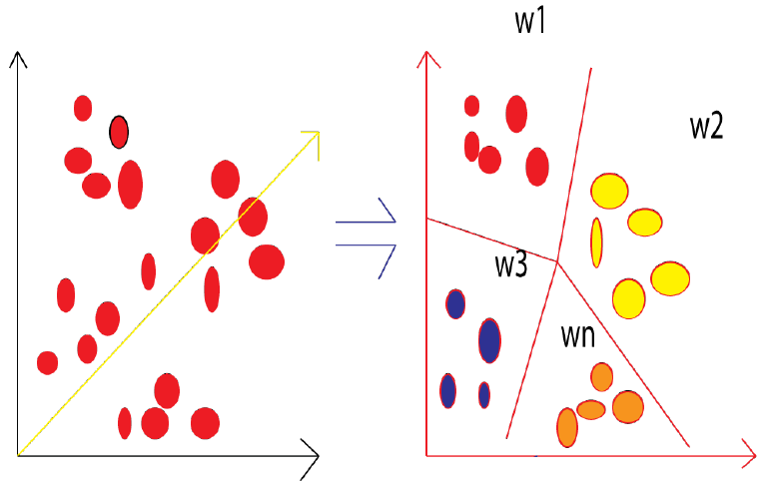
Example of existing solution: Sign Classification
Classification shapes using SVM, KNN, k-means:

Slide 8
Method
The method is described in the article is based on Mask R-CNN [1]. Mask R-CNN extends Faster R-CNN [7].
Also some changes in the architecture and data preparation were made .

Slide 9
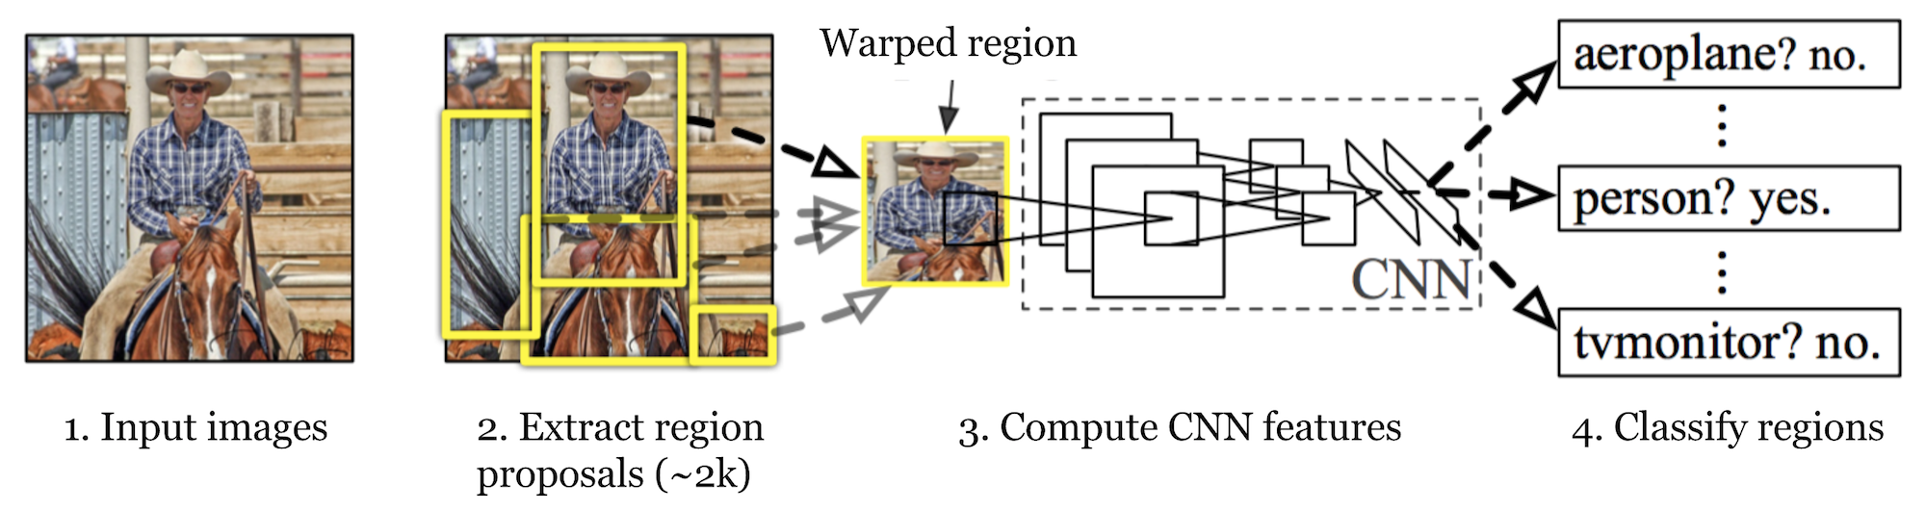
R-CNN
R-CNN [8] is short for “Region-based Convolutional Neural Networks”. The main idea is composed of two steps.
First, using Selective Search [9] or some other region proposal algorithm, it identifies a manageable number of bounding-box object region candidates (“region of interest” or “RoI”).
And then it extracts CNN features from each region independently for classification.

Slide 10
Region proposal
Region proposals are just smaller parts of the original image, that we think could contain the objects we are searching for. There are different region proposal algorithms we can choose from. Examples:
Sliding window.
Selective Search.

Slide 11
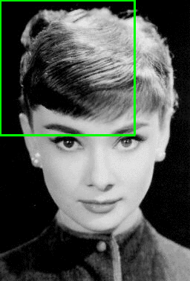
Sliding window
A sliding window is a rectangular region of fixed width and height that “slides” across an image.
When using this method you just go over the whole image with different sized rectangles and look at those smaller images in a brute-force-method.
The problem is you will have a giant number of smaller images to look at.

Slide 12
Selective search
Selective Search [9] is a region proposal algorithm used in object detection.
It is designed to be fast with a very high recall.
It is based on computing hierarchical grouping of similar regions based on color, texture, size and shape compatibility.

Slide 13

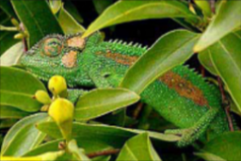
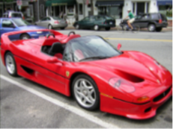
Selective search (cont.)
Color of the cats is different but textures are same.
Chameleon and grass.
Colors are similar but textures are different.
Car and wheels. There no color or texture similarity. But there is size and shape similarity between wheel and fender (wing).

Slide 14
Selective search (cont.)
Selective Search algorithm takes performs the following steps:
Initialize proposal regions
Add all bounding boxes corresponding to segmented parts to the list of regional proposals
Group adjacent segments based on similarity
Go to step 2
At each iteration, larger segments are formed and added to the list of region proposals. Hence we create region proposals from smaller segments to larger segments in a bottom-up approach.

Slide 15
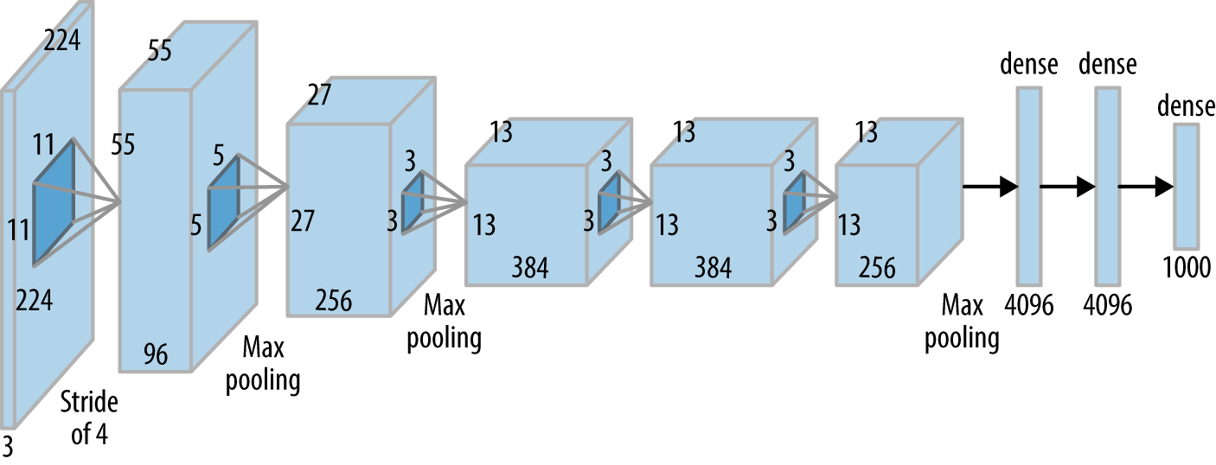
CNN
In the next step, we take each region proposal and we will create a feature vector representing this image in a much smaller dimension using a Convolutional Neural Network (CNN).
They use the AlexNet architecture [12] as a feature extractor.

Slide 16
SVM
At the previous step we created feature vectors from the image proposals.
Now we will need to classify those feature vectors. We want to detect what class of object those feature vectors represent.
For this purpose we use an Support Vector Machine classifier. We have one SVM for each object class and we use them all.

Slide 17
Problem with R-CNN
Each image needs to classify 2000 region proposals. So, it takes a lot of time to train the network.
It requires 49 seconds to detect the objects in an image on GPU.
To store the feature map of the region proposal, lots of disk space is also required.

Slide 18
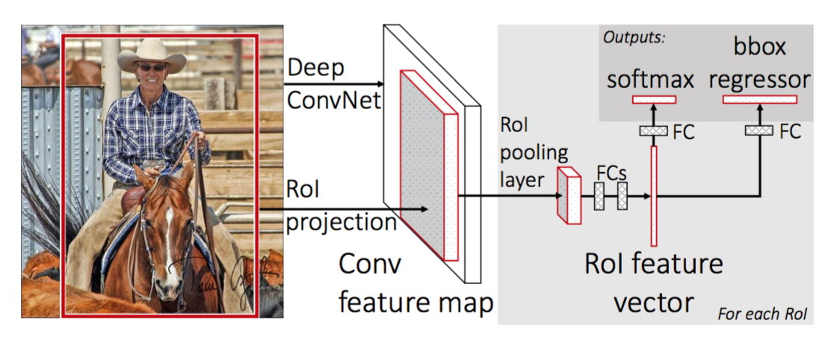
Fast R-CNN
In R-CNN we passed each region proposal one by one in the CNN architecture and selective search generated around 2000 region proposal for an image. So, it is computationally expensive to train and even test the image using R-CNN.
To deal with this problem Fast R-CNN [10] was proposed, It takes the whole image and region proposals as input in its CNN architecture in one forward propagation.

Slide 19
Fast R-CNN (cont.)
Fast R-CNN drastically improves the training (8.75 hrs vs 84 hrs) and detection time from R-CNN. It also improves Mean Average Precision (mAP) [22] marginally as compare to R-CNN.
Most of the time taken by Fast R-CNN during detection is a selective search region proposal generation algorithm.

Slide 20
Faster R-CNN
The bottleneck of the architecture Fast R-CNN is Selective Search. Since it needs to generate 2000 proposals per image.
In Faster R-CNN [11], it was replaced by the region proposal network.

Slide 21
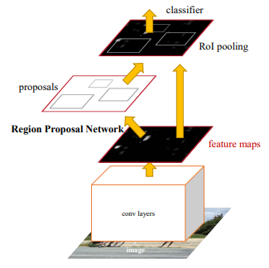
Faster R-CNN (cont.)

Slide 22
Comparison Between R-CNN, Fast R-CNN and Faster R-CNN
In terms of Detection time, Faster R-CNN is faster than both R-CNN and Fast R-CNN. The Faster R-CNN also has better mAP than both the previous ones.
 | R-CNN | Fast R-CNN | Faster R-CNN
Method For Generating Region Proposals | Selective Search | Selective Search | Region Proposal Network
The mAP on Pascal VOC 2007 test dataset(%) | 58.5 | 66.9 (when trained with VOC 2007 only) 70.0 (when trained with VOC 2007 and 2012 both) | 69.9(when trained with VOC 2007 only) 73.2 (when trained with VOC 2007 and 2012 both) 78.8(when trained with VOC 2007 and 2012 and COCO)
The mAP on Pascal VOC 2012 test dataset (%) | 53.3 | 65.7 (when trained with VOC 2012 only) 68.4 (when trained with VOC 2007 and 2012 both) | 67.0(when trained with VOC 2012 only) 70.4 (when trained with VOC 2007 and 2012 both) 75.9(when trained with VOC 2007 and 2012 and COCO)
Detection Time (sec) | ~ 49 (with region proposal generation) | ~ 2.32(with region proposal generation) | 0.2 (with VGG), 0.059 (with ZF)

Slide 23
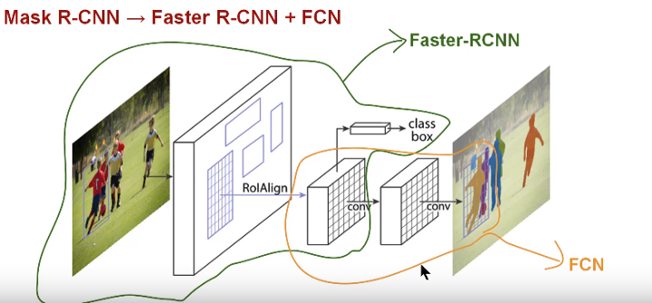
Mask R-CNN
Mask R-CNN [1] extends Faster R-CNN to pixel-level image segmentation.
It was added a mask branch for predicting an object.
The mask branch is a small Fully Convolution Network [13] applied to each RoI, predicting a segmentation mask in a pixel-to-pixel manner.

Slide 24
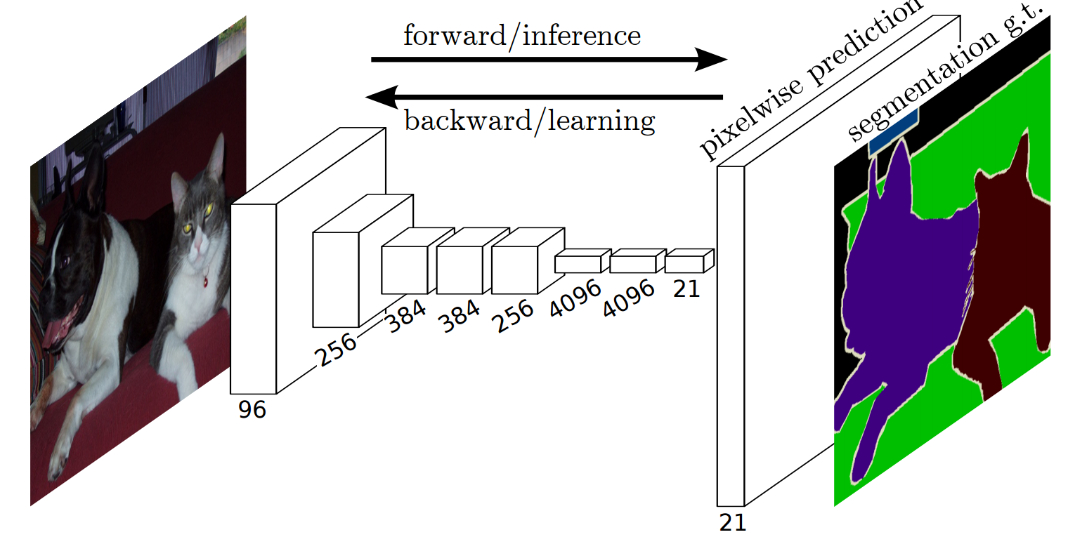
Fully Convolutional Network (FCN)
FCN is a popular algorithm for doing semantic segmentation.

Slide 25
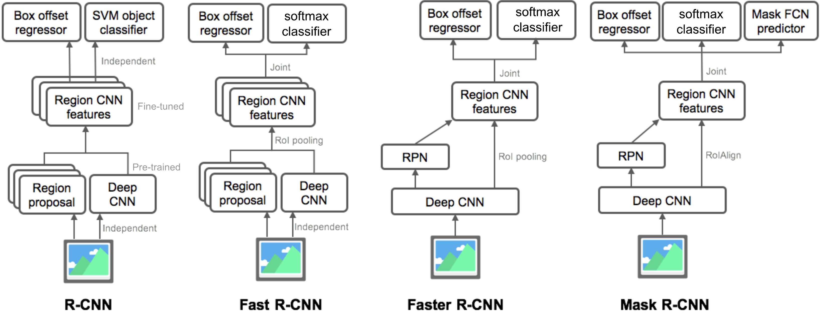
Summary of Models in the R-CNN family

Slide 26
Improvements
Online Hard Example Mining (OHEM). The core idea of ​​the algorithm is to filter according to the loss of the input samples, filter out the hard example, which indicates the samples that have a great influence on the classification and detection.
Sample weighting. There are often many more background regions then the foreground. The learning process will observe background objects more often and will focus on learning the background instead of on the foreground. They address this problem with smaller weights for the background regions, which forces the network to learn foreground objects first.

Slide 27
Improvements (cont.)
Distribution of selected training samples. Large objects in the image have a large number of ROIs, while small objects have only a small number of ROIs, this causes the larger objects will be observed more often and favored much more than the smaller ones. They fixed this by selecting the same number of ROIs for each object present in the image.
Adjusting region pass-through during detection. They changed the number of ROIs passed from the Region Proposal Network to the classification network during the detection stage. This number is adjusted due to a large number of small objects that are commonly present in the traffic-sign domain.

Slide 28
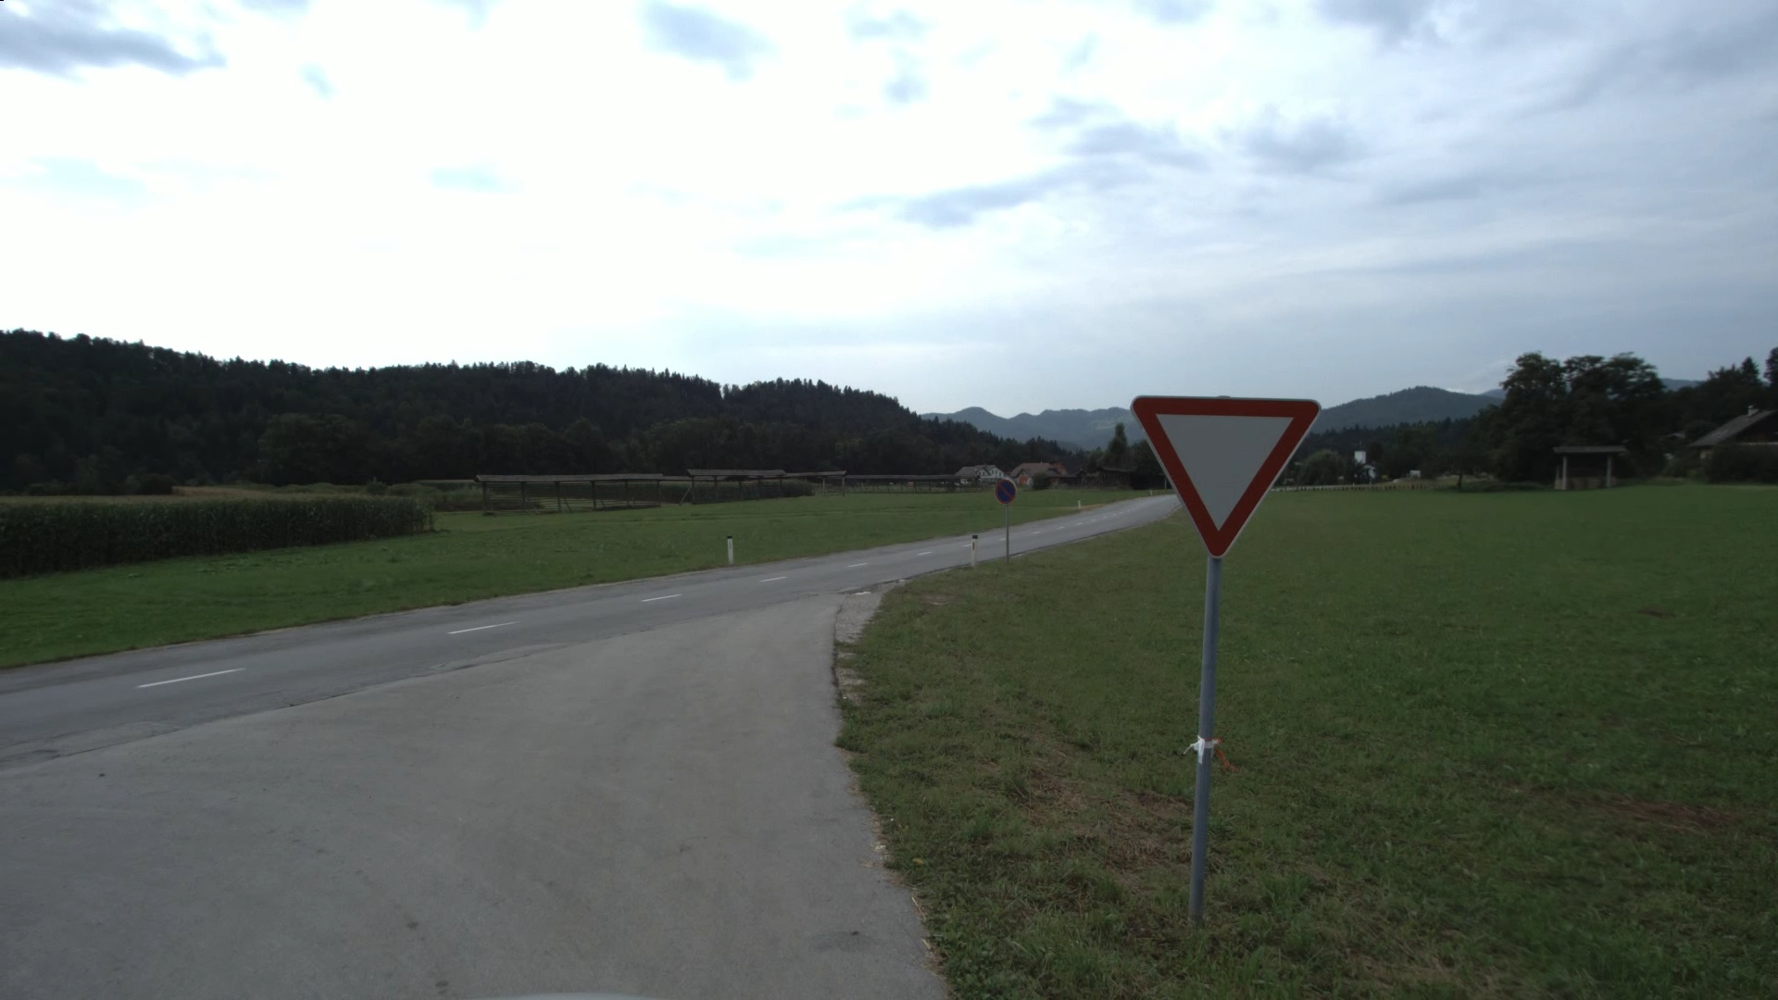
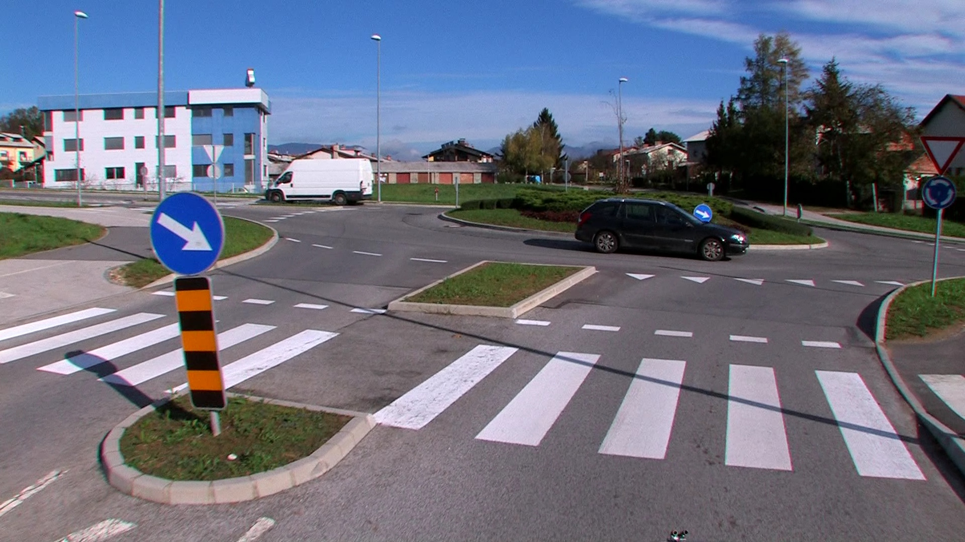
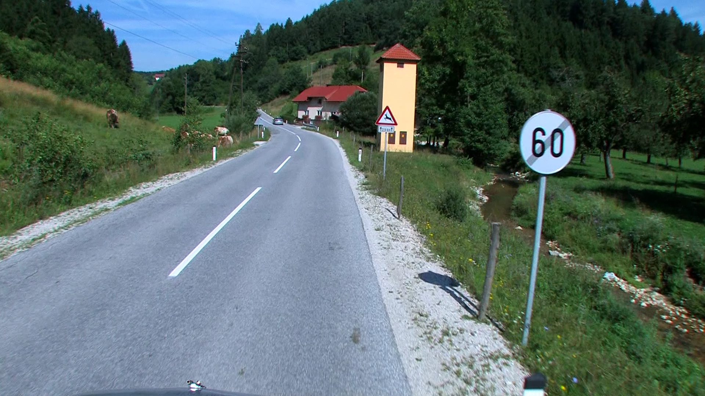
Dataset
The dataset that was chosen for this approach is DFG Traffic Sign Dataset [14].
Dataset consists of 200 traffic sign categories captured in Slovenian roads spanning in around 7000 high-resolution images.

Slide 29
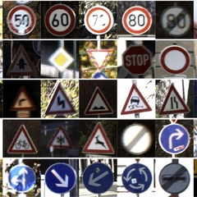
Data augmentation
Data augmentation is a technique to artificially create new training data from existing training data.
Due to millions of learnable parameters the system becomes undetermined without a sufficient number of training samples.

Slide 30
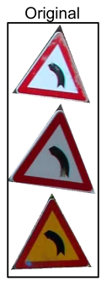
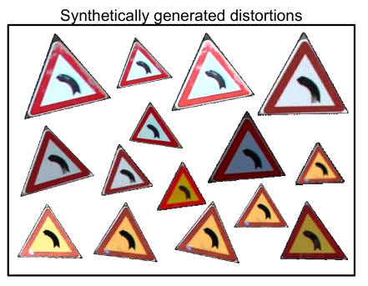
Data augmentation (cont.)
They use synthetic traffic-sign instances are created by modifying segmented, real-world training samples.

Slide 31
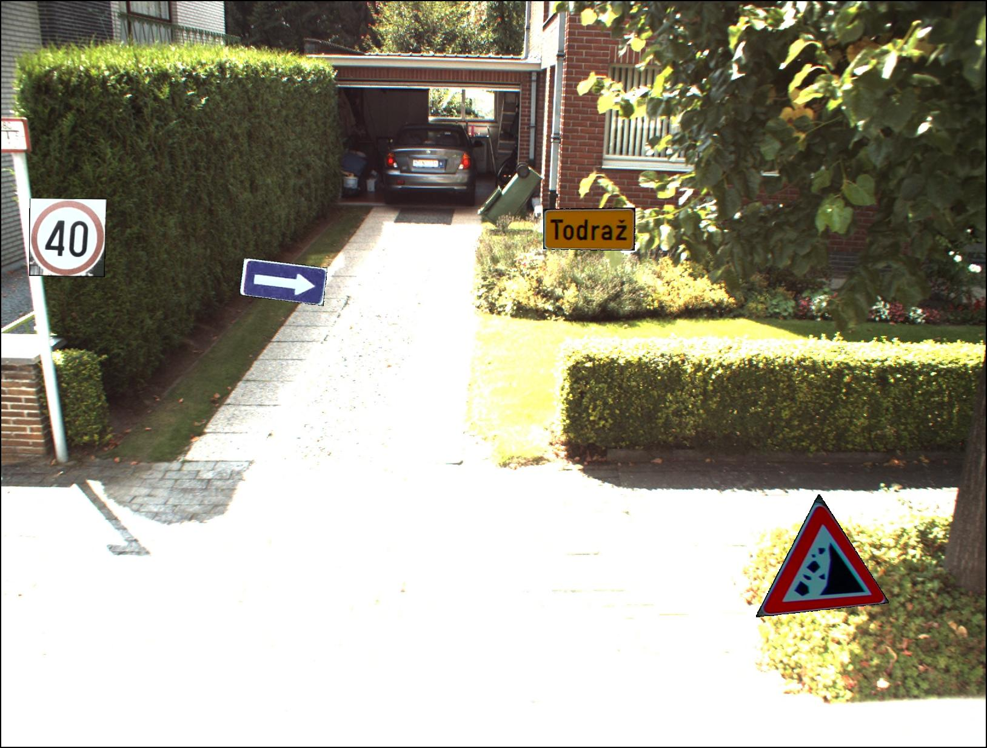
Data augmentation (cont.)

Slide 32
Implementation
The project is implemented [15] using the Detectron framework [16] that is Facebook AI Research's software system that implements state-of-the-art object detection algorithms.
Using Cafee2 [17] – deep learning framework.
Programming language is Python.
Implementations were created for both Faster and Mask R-CNN.
For the Faster R-CNN, they employed the VGG16 [18] network with 13 convolutional layers and 3 fully-connected layers.
For the Mask R-CNN, they employed a residual network [19] with 50 convolutional layers (ResNet-50).

Slide 33

VGG16 – Convolutional Network for Classification and Detection

Slide 34
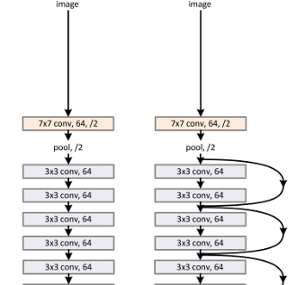
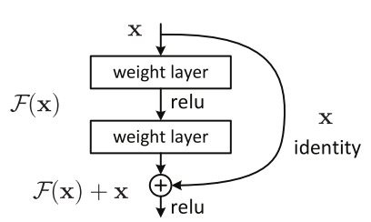
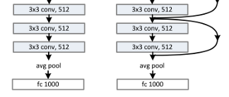
Residual networks

Slide 35
mAP (mean Average Precision) for Object Detection
AP (Average precision) [22] is a popular metric in measuring the accuracy of object detectors like Faster R-CNN, SSD, etc.
Average precision computes the average precision value for recall value over 0 to 1.
They used two variants of the mAP: mAP50, based on the PASCAL visual object challenge [20], and mAP(50:95), based on the COCO challenge [21].

Slide 36
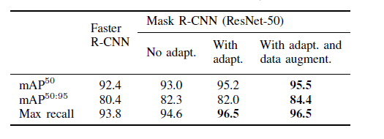
Results Evaluation on DFG traffic-sign dataset
200 categories of traffic signs.
5254 training and 1703 testing images.
Using only annotations with at least 30 pixels in size.
They resized images in all variants of Faster/Mask R-CNN to have image sizes of at least 840 pixels in both width and height.

Slide 37
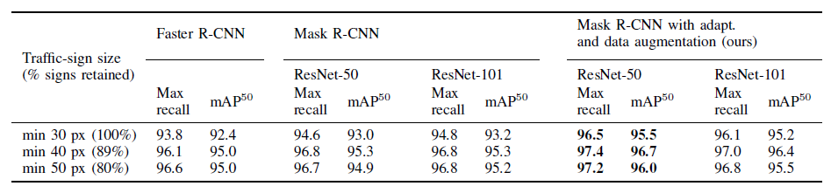
Results Evaluation on DFG traffic-sign dataset (cont.)
They performed evaluation considering different traffic-sign sizes with the results reported in the table:

Slide 38
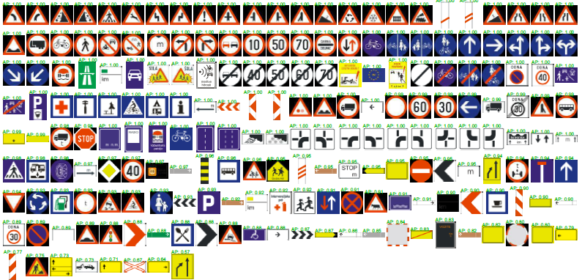
Results Evaluation on DFG traffic-sign dataset (cont.)
DFG traffic-sign categories sorted by average precision calculated when using Mask R-CNN ResNet-50 with our adaptations and data augmentation:

Slide 39
Traffic signs recognition project
Dataset: DFG Traffic Sign Data Set [14] - traffic signs images in JPEG format.
Programming Language: Python 3
Software: Spyder 3.3.6 / IPython 7.8.0 – development environment.
VGG Image Annotator (VIA) [23] - an image annotation tool that can be used to define regions in an image and create textual descriptions of those regions.
Technologies/Methods: Mask R-CNN (mrcnn 0.2 [24])
Description: The application is trained to detect/recognize specific traffic signs.

Slide 40
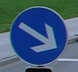



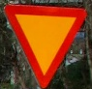
Traffic signs recognition project (cont.)
5 traffic signs were chosen for training/recognition:
62 images were chosen for training, 31 images for validation and 23 images for testing.
Each image contains 1-3 traffic signs.
Most of signs belong to the selected group.
Some images contain traffic signs that are not from the group.

Slide 41
Traffic signs recognition project (cont.)
Results:
On all the test images all the traffic sign that are defined in the group were recognized correct.
Errors:
Some traffic sign that are not defined in the group were detected incorrect.
Very small traffic signs are not detected/recognized.

Slide 42
References
H. Kaiming, G. Gkioxara, P. Dollar, and R. Girshick, “Mask R-CNN,” in International Conference on Computer Vision, 2017, pp. 2961–2969.
M. Haloi, “A novel pLSA based Traffic Signs Classification System,” CoRR, vol. abs/1503.0, 2015.
Y. Zhu, C. Zhang, D. Zhou, X. Wang, X. Bai, and W. Liu, “Traffic sign detection and recognition using fully convolutional network guided proposals,” Neurocomputing, vol. 214, pp. 758–766, 2016.
Z. Zhu, D. Liang, S. Zhang, X. Huang, B. Li, and S. Hu, “Traffic-Sign Detection and Classification in the Wild,” in CVPR, 2016, pp. 2110–2118.
A. Mogelmose, M. M. Trivedi, and T. B. Moeslund, “Vision-Based Traffic Sign Detection and Analysis for Intelligent Driver Assistance Systems: Perspectives and Survey,” Transactions on Intelligent Transportation Systems, vol. 13, no. 4, pp. 1484–1497, 2012.

Slide 43
References (cont.)
Dalal, N., & Triggs, B. (2005, June). Histograms of oriented gradients for human detection. In 2005 IEEE computer society conference on computer vision and pattern recognition (CVPR'05) (Vol. 1, pp. 886-893). Ieee.
S. Ren, K. He, R. Girshick, and J. Sun, “Faster R-CNN: Towards Real- Time Object Detection with Region Proposal Networks,” in NIPS, 2015.
Girshick, R., Donahue, J., Darrell, T., & Malik, J. (2014). Rich feature hierarchies for accurate object detection and semantic segmentation. In Proceedings of the IEEE conference on computer vision and pattern recognition (pp. 580-587).
Uijlings, J. R., Van De Sande, K. E., Gevers, T., & Smeulders, A. W. (2013). Selective search for object recognition. International journal of computer vision, 104(2), 154-171.
Girshick, R. (2015). Fast r-cnn. In Proceedings of the IEEE international conference on computer vision (pp. 1440-1448).

Slide 44
References (cont.)
Ren, S., He, K., Girshick, R., & Sun, J. (2015). Faster r-cnn: Towards real-time object detection with region proposal networks. arXiv preprint arXiv:1506.01497.
Krizhevsky, A., Sutskever, I., & Hinton, G. E. (2012). Imagenet classification with deep convolutional neural networks. Advances in neural information processing systems, 25, 1097-1105.
Long, J., Shelhamer, E., & Darrell, T. (2015). Fully convolutional networks for semantic segmentation. In Proceedings of the IEEE conference on computer vision and pattern recognition (pp. 3431-3440).
DFG Traffic Sign Dataset: http://www.vicos.si/Downloads/DFGTSD
Detectron for Traffic Signs: https://github.com/skokec/detectron-traffic-signs
Detectron framework: https://github.com/facebookresearch/detectron
Cafee2: https://github.com/facebookarchive/caffe2

Slide 45
References (cont.)
K. Simonyan and A. Zisserman, “Very Deep Convolutional Networks for Large-Scale Image Recognition,” in International Conference on Learning Representations, 2015, pp. 1–14.
K. He, X. Zhang, S. Ren, and J. Sun, “Deep Residual Learning for Image Recognition,” in CVPR, 2016, pp. 171–180.
Everingham, M., Eslami, S. A., Van Gool, L., Williams, C. K., Winn, J., & Zisserman, A. (2015). The pascal visual object classes challenge: A retrospective. International journal of computer vision, 111(1), 98-136.
Lin, T. Y., Maire, M., Belongie, S., Hays, J., Perona, P., Ramanan, D., ... & Zitnick, C. L. (2014, September). Microsoft coco: Common objects in context. In European conference on computer vision (pp. 740-755). Springer, Cham.
mAP (mean Average Precision) for Object Detection: https://jonathan-hui.medium.com/map-mean-average-precision-for-object-detection-45c121a31173

Slide 46
References (cont.)
VGG Image Annotator: https://www.robots.ox.ac.uk/~vgg/software/via/
Mask R-CNN python library (mrcnn 0.2): https://pypi.org/project/mrcnn/

